Slide 1
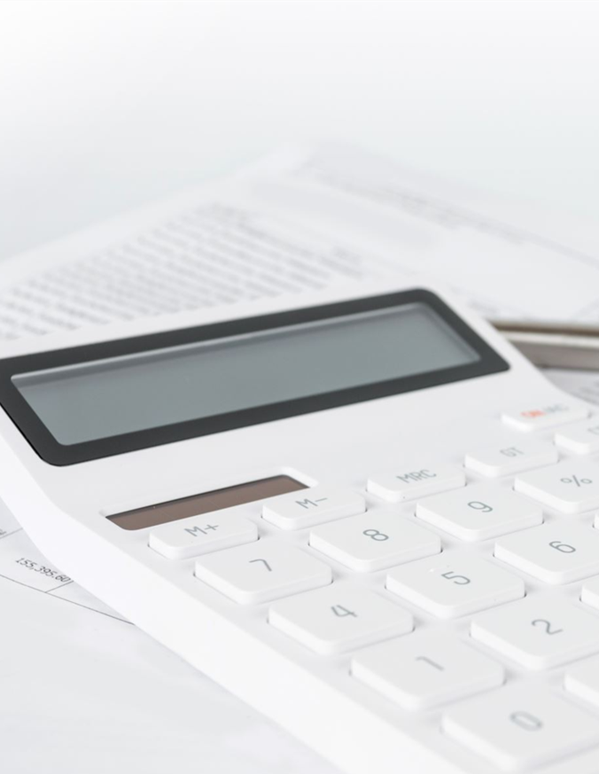
Fluid Replacement Calculator for Nurses and Midwives
Peter Mvuma,
MSc Health Informatics
Michigan Technological University

Slide 2
Introduction
In many remote areas of Malawi, nurses are often faced with managing cases of dehydration without quick access to detailed clinical guidelines or digital tools.
This can lead to inaccuracies in fluid replacement calculations, delayed treatment, and compromised patient care.

Slide 3
Overall Summary of the Calculator/project
Description
Using WHO guidelines (Plan A, B, C). It supports patient data logging, export, and visualization.
Features
Calculation of fluid requirements based on age, weight, and dehydration level & presence of shock/not
Saves results to MySQL database
Logs data into a CSV file
Generates printable PDF reports
Displays fluid totals in a bar chart for patient trend analysis
A GUI-based tool that automates fluid therapy calculations for patients with dehydration,

Slide 4
Main Goal and Application of the Project
GOAL: To assist nurses with accurate fluid therapy decisions, especially in remote and high-demand areas.
Based on WHO guidelines for managing dehydration and fluid loss.
Automates calculations, stores patient data, and generates printable reports.
Enhances efficiency, standardizes care, and minimizes human error.

Slide 5
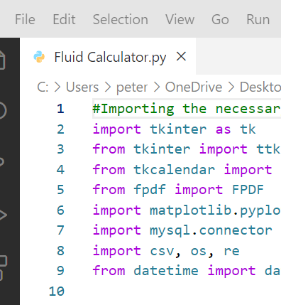
Python Libraries used
User Interface
tkinter – GUI builder
ttk, messagebox – Themed widgets & alerts
tkcalendar.DateEntry – Date picker
PDF Generation
Creating & exporting pdf reports
Visualization
Plot fluid trends
MySQL
Database access
Files & Validation
csv – Read/write CSV
os – File system operations
Re–input validation
Date/Time
datetime – Manage timestamps

Slide 6
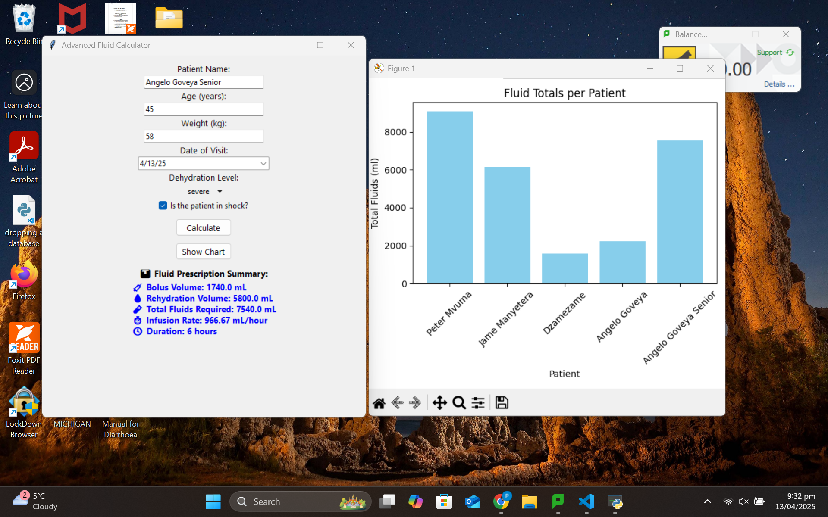
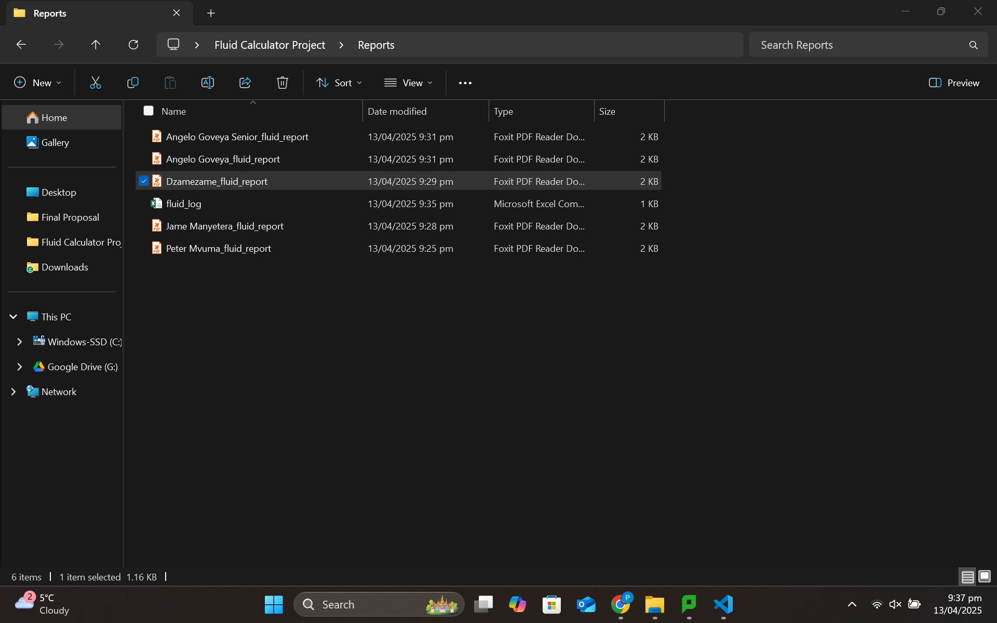
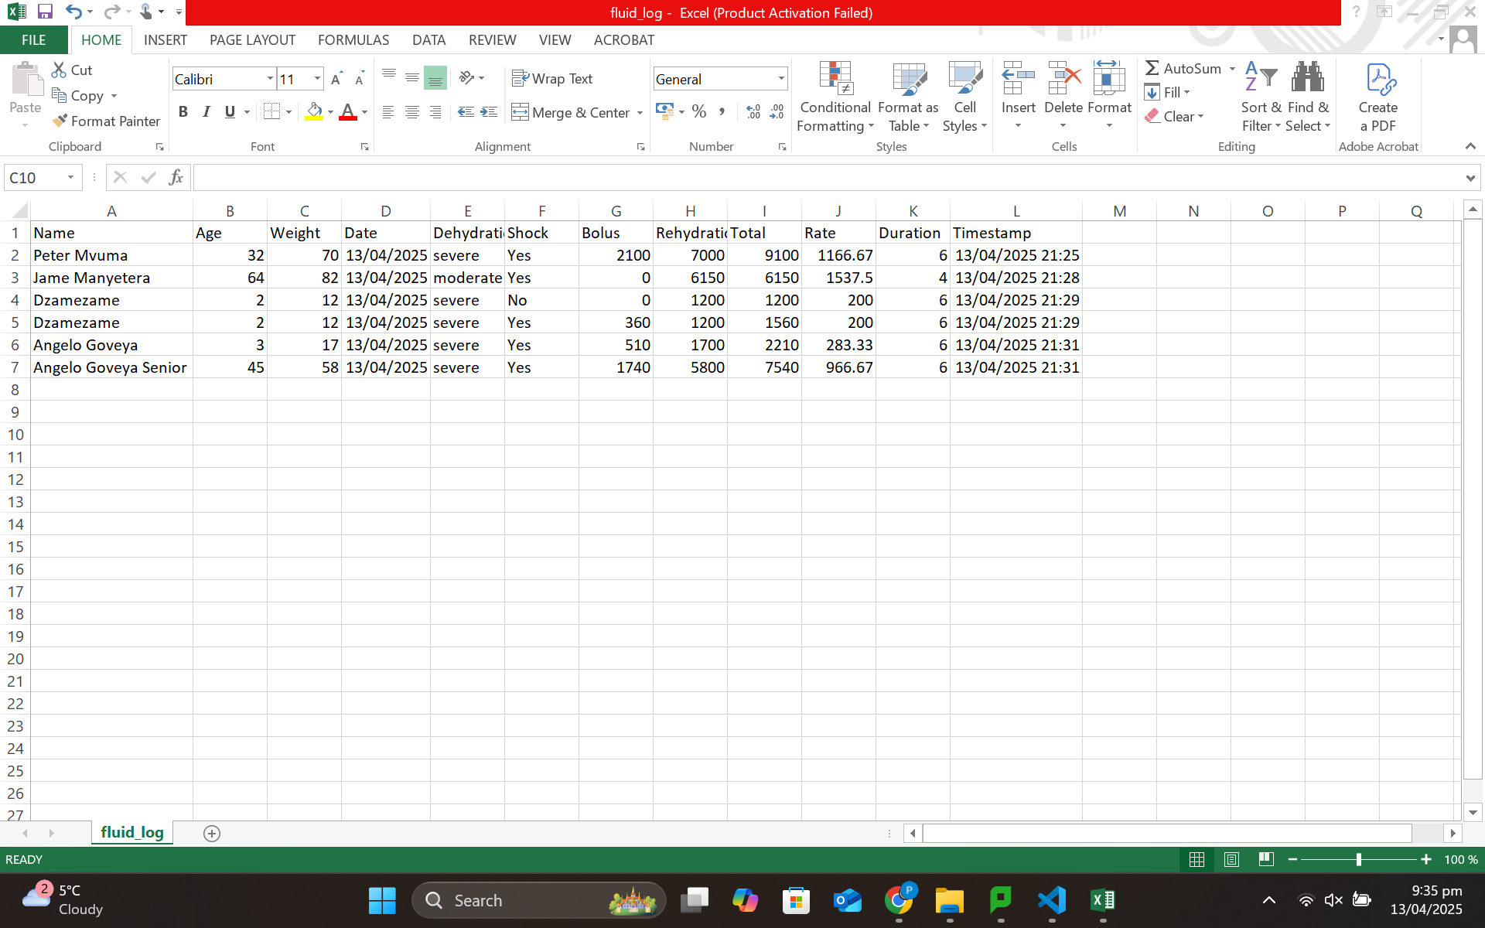
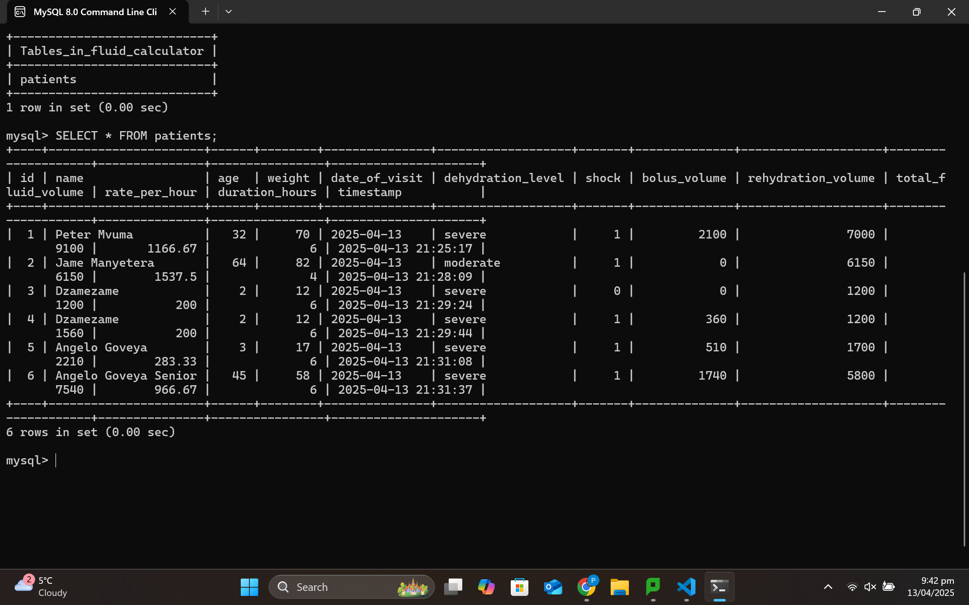

Slide 7
Impact & possible Way Forward
• Reduces calculation errors and standardizes patient fluid management.
• Supports digital transformation in clinical environments.
• Enhances nurse decision-making through automation.
• Possible Next steps: Validation with experts, deploy in hospitals and health centers, add cloud backup, and multilingual support.

